Slide 1

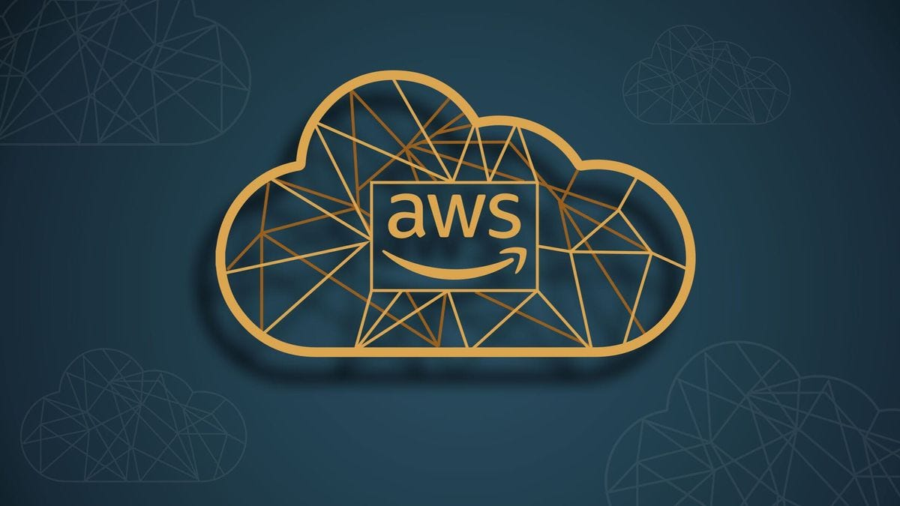
AWS Application Services

Slide 2
What are AWS Application Services?
A suite of managed services designed to facilitate the development, deployment, and management of applications.
Provides tools for compute, storage, databases, messaging, and application orchestration.
Objective:
To streamline application development, reduce operational overhead, and improve scalability and performance.

Slide 3
AWS Lambda
Serverless compute service that runs code in response to events.
Automatically scales and manages the infrastructure.
Key Features:
No server management.
Pay only for the compute time used.
Integrates with other AWS services.
Use Cases:
Data processing, real-time file processing, backend services for web and mobile apps.

Slide 4
Amazon API Gateway
Fully managed service to create, publish, maintain, monitor, and secure APIs.
Key Features:
Supports RESTful APIs and WebSocket APIs.
Integrates with Lambda for serverless backends.
Provides monitoring and throttling.
Use Cases:
Building APIs for web and mobile applications, exposing microservices.

Slide 5
Amazon SQS (Simple Queue Service)
Fully managed message queuing service that enables decoupling of components in distributed systems.
Key Features:
Scalable and reliable message queuing.
Supports FIFO and standard queues.
Integrates with other AWS services.
Use Cases:
Asynchronous processing, task scheduling, message buffering.

Slide 6
Amazon SNS (Simple Notification Service)
Managed service for sending notifications from the cloud.
Key Features:
Supports pub/sub messaging and notifications to mobile devices, email, and SMS.
Easy integration with other AWS services.
Use Cases:
Application alerts, mobile push notifications, email notifications.

Slide 7
Amazon DynamoDB
Managed NoSQL database service with fast and predictable performance.
Key Features:
Key-value and document data models.
Built-in high availability and durability.
Supports automatic scaling and global tables.
Use Cases:
Real-time data processing, gaming backends, IoT applications.

Slide 8
AWS AppSync
Managed service for building GraphQL APIs.
Key Features:
Simplifies data retrieval from multiple sources.
Integrates with DynamoDB, Lambda, and other data sources.
Supports real-time updates and offline access.
Use Cases:
Building scalable APIs for web and mobile applications.

Slide 9
Conclusion
AWS Application Services offer a range of tools to support different aspects of application development and deployment.
Services like Lambda, API Gateway, and DynamoDB enable building scalable, reliable, and efficient applications.

